Slide 1
Comparison of Bubble Sort Insertion Sort, and Selection Sort
By Zukile Ndyalivana

Slide 2
Optimized Bubble Sort Algorithm
To optimize our bubble sort algorithm, we can introduce a flag to monitor whether elements are getting swapped inside the inner for loop.
Hence, in the inner for loop, we check whether swapping of elements is taking place or not, everytime.
If for a particular iteration, no swapping took place,
it means the array has been sorted and we can jump out of the for loop, instead of executing all the iterations.
Let's consider an array with values {11, 17, 18, 26, 23}
Below, we have a pictorial representation of how the optimized bubble sort will sort the given array.

Slide 3
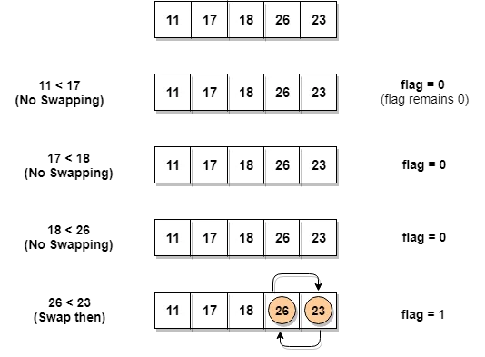

Slide 4
Emplemntation of an Optimized Bubble Sort
Bubble sort is by using a flag in a while loop to determine if the given list is sorted or not.
Each loop will bubble up the largest value(smallest value for descending order) of the remaining unsorted elements to the correct position.
Bubble up means the swap of two values,
when looping through each element in the list, if the value of the current position is larger than the value of the next position, swap them and set the swapped flag to true,
so that the next outer while loop will loop through list again to do the next round of bubbling.
Each inner loop will bubble up one value to the correct position, thus the number of inner loops will decrease by 1 in the next iteration.

Slide 5
Time Complexity:
Best Case Sorted array as input. Or almost all elements are in proper place. [ O(N) ]. O(1) swaps.
Worst Case: Reversely sorted / Very few elements are in proper place. [ O(N^2) ] . O(N2) swaps.
Average Case: [ O(N2) ] . O(N2) swaps.
Space Complexity: A temporary variable is used in swapping
[ auxiliary, O(1) ]. Hence it is In-Place sort.

Slide 6
Insertion Sort Algorithm
Insertion sort starts by assuming the first element in the list is already sorted,
then loops through the rest of elements in the list and inserts each element into the correction position in the previous sorted elements.
There will be an outer loop that goes through each element and this element will be saved to a temporary variable.
An inner loop will go backwards starting from the current index-1 until it reaches to the first position or it finds the correct position for the element of the current outer index.
Each of the inner loop will move the element one position up if it hasn’t find a correct position for the value to be inserted, which is the value of the current outer loop index which is saved in the temporary variable.
This temporary variable will be inserted to the correct position once the inner loop finds the correct position for it.

Slide 7
Another Example:
12, 11, 13, 5, 6
Let us loop for i = 1 (second element of the array) to 4 (last element of the array)
i = 1. Since 11 is smaller than 12, move 12 and insert 11 before 12
11, 12, 13, 5, 6
i = 2. 13 will remain at its position as all elements in A[0..I-1] are smaller than 13
11, 12, 13, 5, 6
i = 3. 5 will move to the beginning and all other elements from 11 to 13 will move one position ahead of their current position.
5, 11, 12, 13, 6
i = 4. 6 will move to position after 5, and elements from 11 to 13 will move one position ahead of their current position.
5, 6, 11, 12, 13

Slide 8
Selection Sort
Selection sort is a sorting algorithm that selects the smallest element from an unsorted list in each iteration and places that element at the beginning of the unsorted list.

Slide 9
Selection Sort
Reduces number of swaps to O(N).
Start at the left end.
Mark the leftmost item, say as min.
Compare this item with the next item, the shortest among two now becomes min.
Keep comparing till the end, the final min item is swapped at placed at position 0.
Then start with position 1 and repeat the process.
The number of comparisons are more but the number of swaps is considerably reduced.
What situation is this sort good for?

Slide 10
Selection Sort
Efficiency:
-- Number of comparisons is same, N*(N-1)/2.
-- runs in O(N²) time.
How do you compare it to Bubble sort?
Faster than bubble sort because of fewer swaps.

Slide 11
Insertion Sort
For already sorted data, runs in O(N) time.
For data arranged in inverse order, runs no faster than bubble sort.

Slide 12
Selection sort selects i-th smallest element and places at i-th position.
This algorithm divides the array into two parts: sorted (left) and unsorted (right) subarray.
It selects the smallest element from unsorted subarray and places in the first position of that subarray (ascending order).
It repeatedly selects the next smallest element.

Slide 13
Insertion Sort Analysis
On the first pass, compares at the most one item, two on second pass and so on. N-1 comparisons in the last pass.
On each pass an average of only half of the maximum number of items are actually compared before the insertion point is found.
N*(N-1)/4 comparisons.
Since there is no swapping, it is twice as faster than bubble sort and faster than selection Sort.
Runs in O(N²) time.

Slide 14
Comparison
Bubble sort is useful for small amounts of data.
Selection sort can be used when amount of data is small and swapping is time-consuming.
Insertion sort is most versatile and the best when the list is almost sorted.

